Slide 1
Chapter 4
PRESENT WORTH METHOD OF COMPARISON

Slide 2
PRESENT WORTH METHOD OF COMPARISON
In this method of comparison, the cash flows of each alternative will be reduced to time zero by assuming an interest rate i. Then, depending on the type of decision, the best alternative will be selected by comparing the present worth amounts of the alternatives.
Followings are the type of the decision problem:
Revenue-dominated cash flow diagram
Cost-dominated cash flow diagram

Slide 3
Revenue-dominated cash flow diagram
In a revenue/profit-dominated cash flow diagram, the profit, revenue, salvage value (all inflows to an organization) will be assigned with positive sign.
The costs (outflows) will be assigned with negative sign.

Slide 4
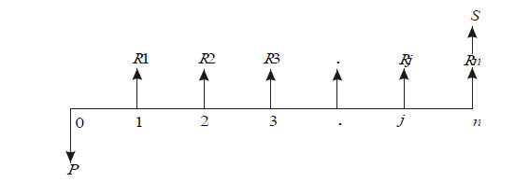
A generalized revenue-dominated cash flow diagram to demonstrate the present worth method of comparison is presented in the Figure.

Slide 5

To find the present worth of the cash flow diagram for a given interest rate, the formula is

Slide 6


Slide 7
Cost-dominated cash flow diagram
In a cost dominated cash flow diagram, the costs (outflows) will be assigned with positive sign, and
the profit, revenue, salvage value (all inflows), etc. will be assigned with negative sign.

Slide 8
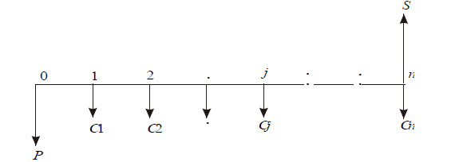
A generalized cost-dominated cash flow diagram to demonstrate the present worth method of comparison is presented in the Figure.

Slide 9

To compute the present worth amount of the above cash flow diagram for a given interest rate i, the formula is:

Slide 10
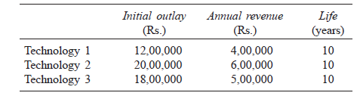
EXAMPLE 1
Alpha Industry is planning to expand its production operation. It has identified three different technologies for meeting the goal. The initial outlay and annual revenues with respect to each of the technologies are summarized in Table. Suggest the best technology which is to be implemented based on the present worth method of comparison assuming 20% interest rate, compounded annually.

Slide 11
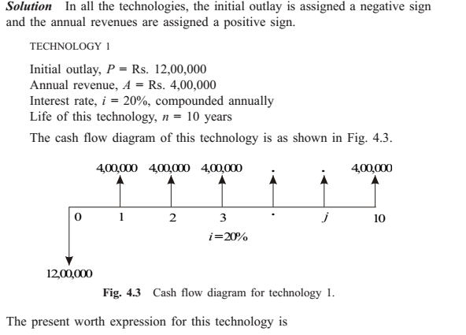

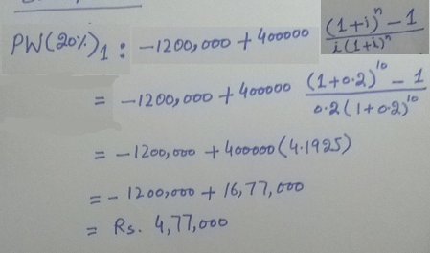

Slide 12
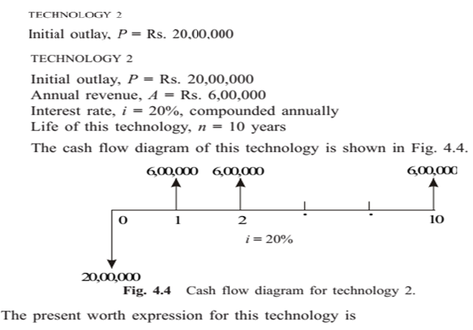
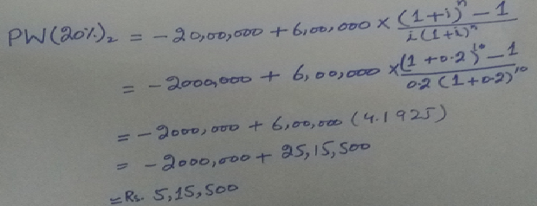
Continue

Slide 13
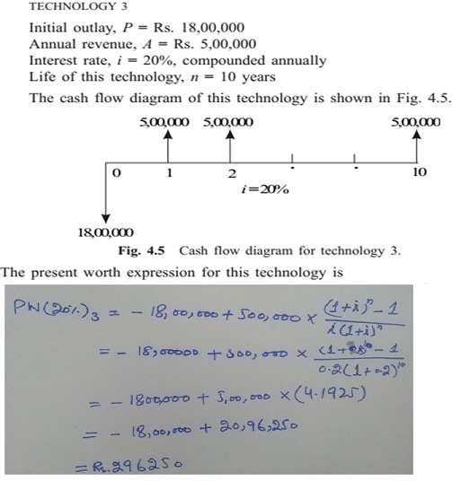

Continue
Notes:
Note: in Revenue relevant questions we’ll select the option which is high in value

Slide 14
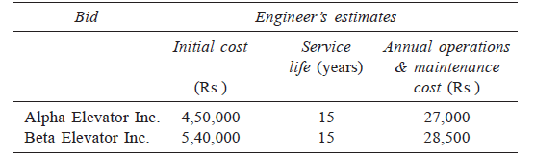
Example 2
An engineer has two bids for an elevator to be installed in a new building. The details of the bids for the elevators are as follows:
Determine which bid should be accepted, based on the present worth method of comparison assuming 15% interest rate, compounded annually.

Slide 15
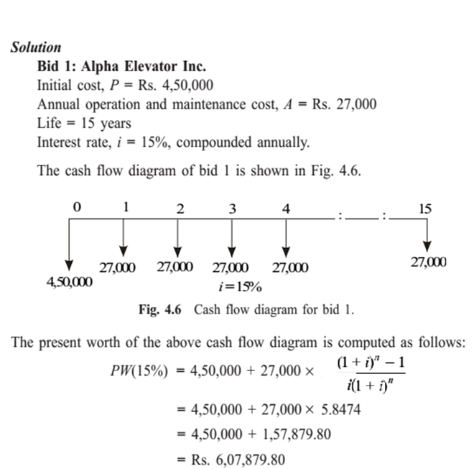

Slide 16
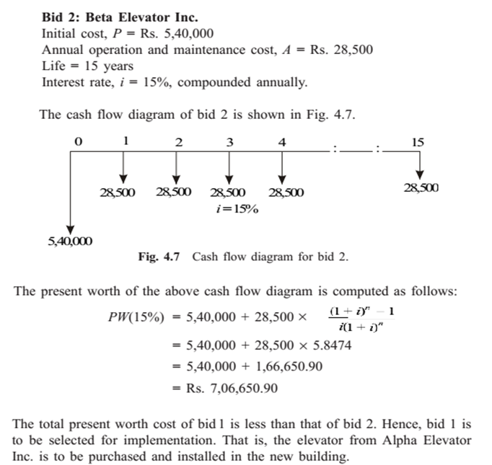
Continue
Notes:
Note: in cost relevant questions we’ll select the option which is low in value

Slide 17
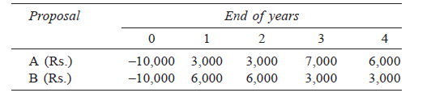
Example 3
Investment proposals A and B have the net cash flows as follows:
Compare the present worth of A with that of B at i = 18%. Which proposal should be selected?

Slide 18
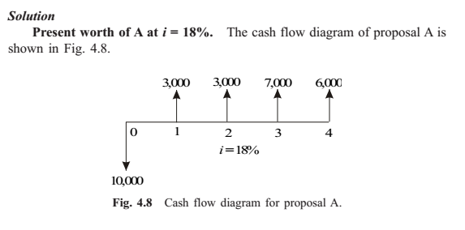
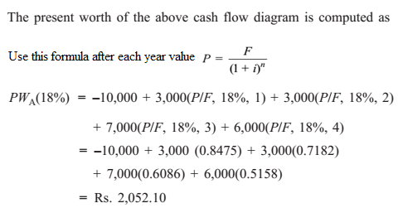
Notes:
In this method we’ll use above mentioned formula of present worth single payment instead equal payment as in this question the separate year is mentioned for each value.

Slide 19
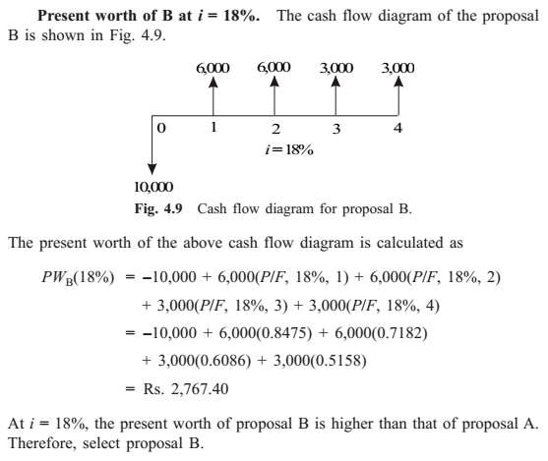
Continue

Slide 20
Example 4
A granite company is planning to buy a fully automated granite cutting machine. If it is purchased under down payment, the cost of the machine is Rs. 16,00,000. If it is purchased under installment basis, the company has to pay 25% of the cost at the time of purchase and the remaining amount in 10 annual equal installments of Rs. 2,00,000 each. Suggest the best alternative for the company using the present worth basis at i = 18%, compounded annually.

Slide 21
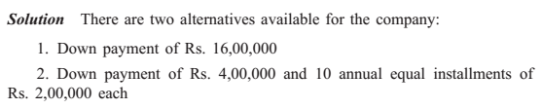
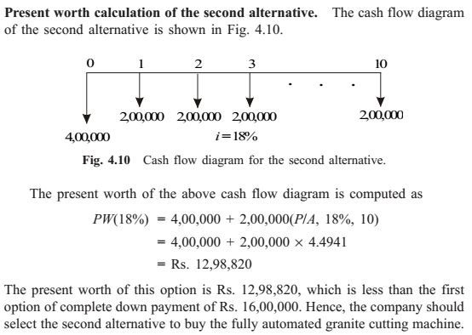
Use this formula as there are equal payments in this method

Slide 22
Example 5
A finance company advertises two investment plans. In plan 1, the company pays Rs. 12,000 after 15 years for every Rs. 1,000 invested now. In plan 2, for every Rs. 1,000 invested, the company pays Rs. 4,000 at the end of the 10th year and Rs. 4,000 at the end of 15th year. Select the best investment plan from the investor’s point of view at i = 12%, compounded annually.

Slide 23
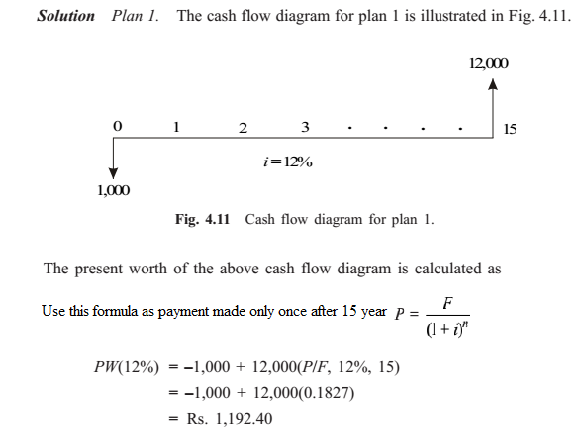

Slide 24
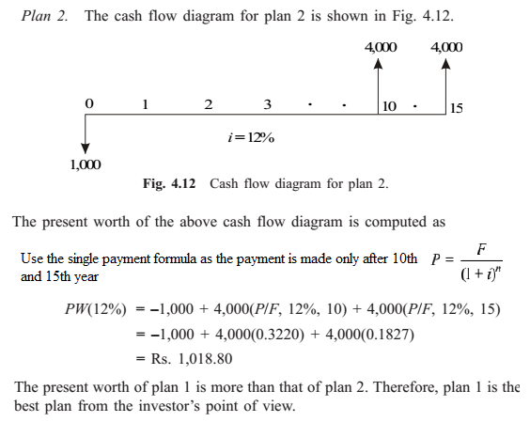
Continue

Slide 25
Example 6
Novel Investment Ltd. accepts Rs. 10,000 at the end of every year for 20 years and pays the investor Rs. 8,00,000 at the end of the 20th year. Innovative Investment Ltd. accepts Rs. 10,000 at the end of every year for 20 years and pays the investor Rs. 15,00,000 at the end of the 25th year. Which is the best investment alternative? Use present worth base with i = 12%.

Slide 26
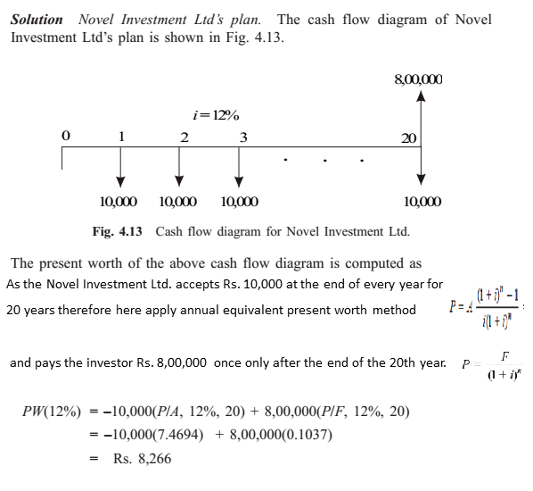

Slide 27
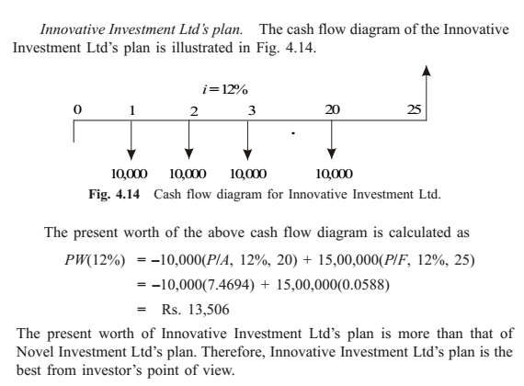
Continue

Slide 28
Example 7
A small business with an initial outlay of Rs. 12,000 yields Rs. 10,000 during the first year of its operation and the yield increases by Rs. 1,000 from its second year of operation up to its 10th year of operation. At the end of the life of the business, the salvage value is zero. Find the present worth of the business by assuming an interest rate of 18%, compounded annually.

Slide 29
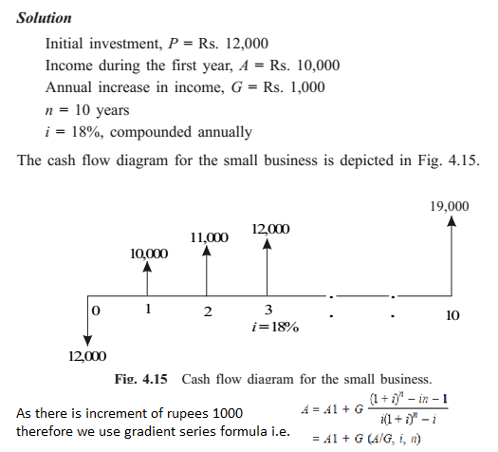

Slide 30


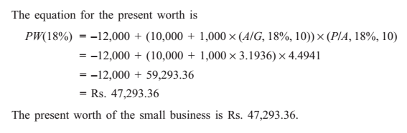
Continue

Slide 31
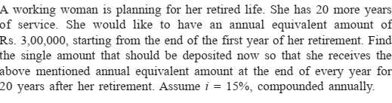
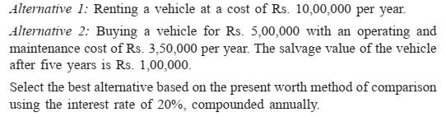

Slide 32
